Slide 1
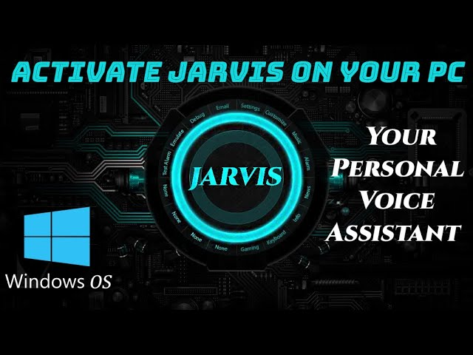
System Assistant (JARVIS)

Slide 2

AGENDA
Introduction.
Overview.
Features.
How it works?
Advantages – Disadvantages.
Commands.
Requirements.
Conclusion.

Slide 3

INTRODUCTION
By the increasing complexity of day to day life in technological era there is a huge need of automate the things in this program we tried to automate the few things that a common person using the things in daily life. We are all aware of popular A.I like Siri (Apple), Google Assistant (Android) by the inspiration of them we tried to automate the things used by the common person.

Slide 4
OVERVIEW
Jarvis is a Personal System Assistant.
Based on the Python Programming Language.
You can assist Jarvis by using voice command.
Searching on Query's(Google, Wikipedia).
A user can do basic usage with just speaking nowadays set a reminder, search on queries, alarms & Whatsapp message..Etc. A voice assistant can easily do each of these things. A user needs to give a command by simply talking to their device. Voice assistants can help us in every walk of life in this modern era.

Slide 5
The forecast of the weather & temperature for the present day and which place of the Particular locality.
It update the live cricket score of matches.
It will entertain to you by telling the Jokes.
It will performs queries in youtube and we can assist the tasks like Mute & Unmute , Volume Up & Volume Down, Play & Pause
Latest News on Different fields like Science, Technology, Health, Business, Sports, Entertainment.
It will block the social media platforms like instagram, facebook by using Focus Mode in Jarvis.

Slide 6
How it Works ?
Start
Live GUI for interaction will appear on Screen.
Perfrom
It will perfrom the required task for the user like opening Notepad, Searching on Browser, Temperature, Focus Mode etc.
Exit
It keeps on asking for the command from user until the user say “Finally Sleep". Once the user say “Finally Sleep", it exits.
Input
It will take input through voice commands related to the task which is required to be done.

Slide 7
Features
Conversations with Jarvis.
Searching from Web(Goggle, Youtube, Wikipedia).
Automating Temperature & Weather.
Automating Time.
Open/Close apps with your Voice.
Set Alarm.
Fully automate youtube controls
Remember function.

Slide 8
Schedule your day.
Internet Speed.
Cricket Score Live .
Rock, Paper & Scissor Game.
Focus Mode.
Calculator.
Whatsapp.

Slide 9

Commands
There are mainly 4 types of commands are given :
speak ()
Takecommand ()
taskExecution ()
Finallysleep ()

Slide 10
Commands
There are mainly 4 types of commands are given :
speak ():
The speak function will be responsible for speaking whatever text is passed to it.
takeCommand ():
The mction is used to take the command as input through microphone of user and returns the outstring.

Slide 11
wishMe():
This function greets the user according to the time like Good morning, Good afternoon and Good Evening.
taskExecution():
This is the function which contains all the necessary task execution definition like searchGoogle(), searchYouTube(), searchWikipedia(), latestnews(), Calculator(), sendMessage(), alarm()..Etc.

Slide 12
Advantages
Easy to use.
Can work with variety of commands.
Custom Commands.
Secure.
Helpful for disabled.
Increases the work productivity

Slide 13
Disadvantages
It Supports English Language only.
At a time Single task will be executed.
Surroundings has to be crystal clear while giving commands.
Supports limited Tasks only.

Slide 14
Requirements
Any Python IDE or visual studio
Third Party python modules like (pyttsx3,bs4,googletrans, pyautogui, pyjokes…etc).
PC or Laptop.
High Speed Internet.
API (Application Programming Interface).

Slide 15
Conclusion
In this “Jarvis - The Personal Voice Assistant” we discussed planning, implementation and application of Digital Assistance. This project is built using open-source software modules with Python communities. The sequential flow of this project makes it more efficient, flexible and easier to add more additional features without disturbing the current system features and functionalities. It works on voice commands and also gives responses to the user supported question/query being asked or the voice command spoken by the user like opening any tasks and performing any operations. It is greeting the user in specific way then user feels liberal to interact with the virtual assistant. The virtual assistant should also eliminate any unnecessary manual work of the user. The entire system works on the verbal voice input.

